Slide 1
Data Riders: Linear Regression Mini-Project
Santhosh Kumar
Yuvaraj Nachimuthu
Ekta Chaurasia
Avishek Deb
Srinath Ganesh
Naren

Slide 2
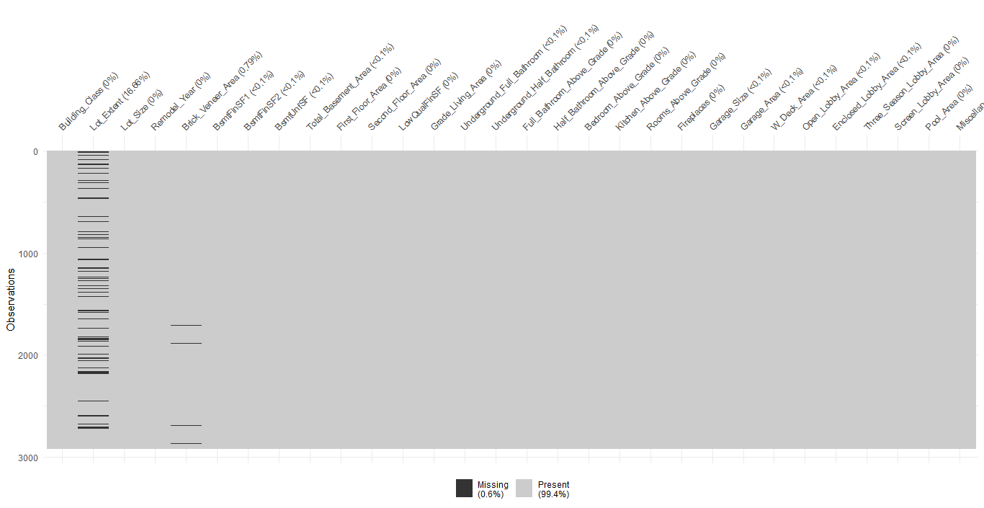
NUMERICAL FEATURES - MISSING VALUES

Slide 3
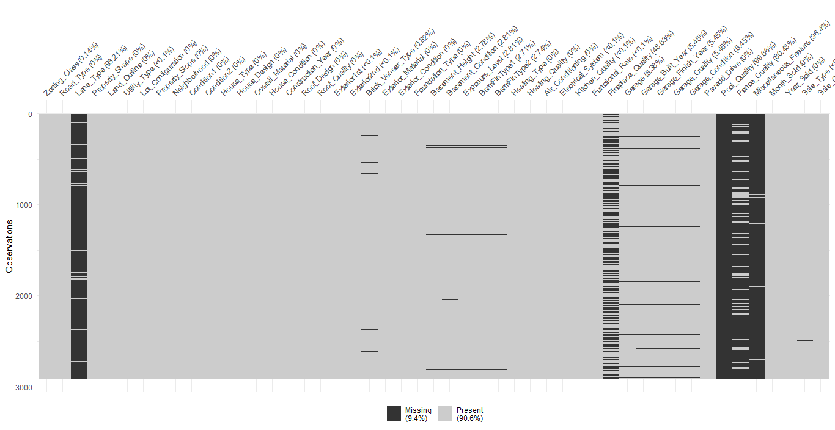
CATEGORICAL FEATURES - MISSING VALUES

Slide 4
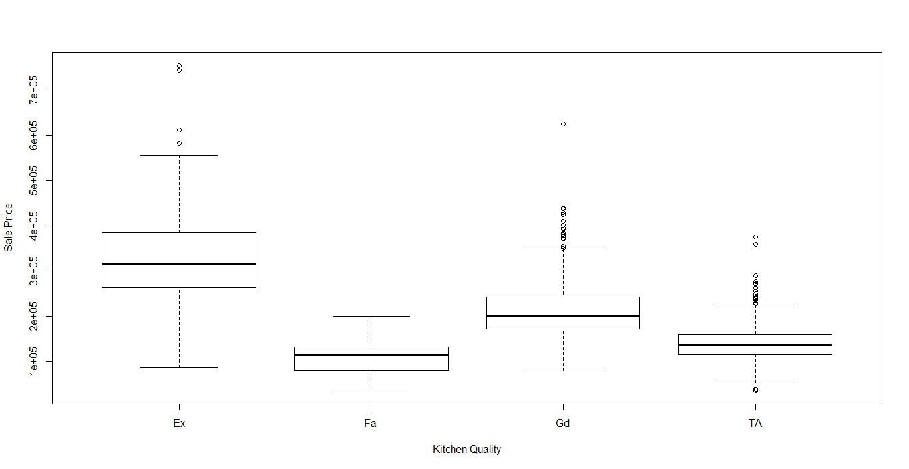
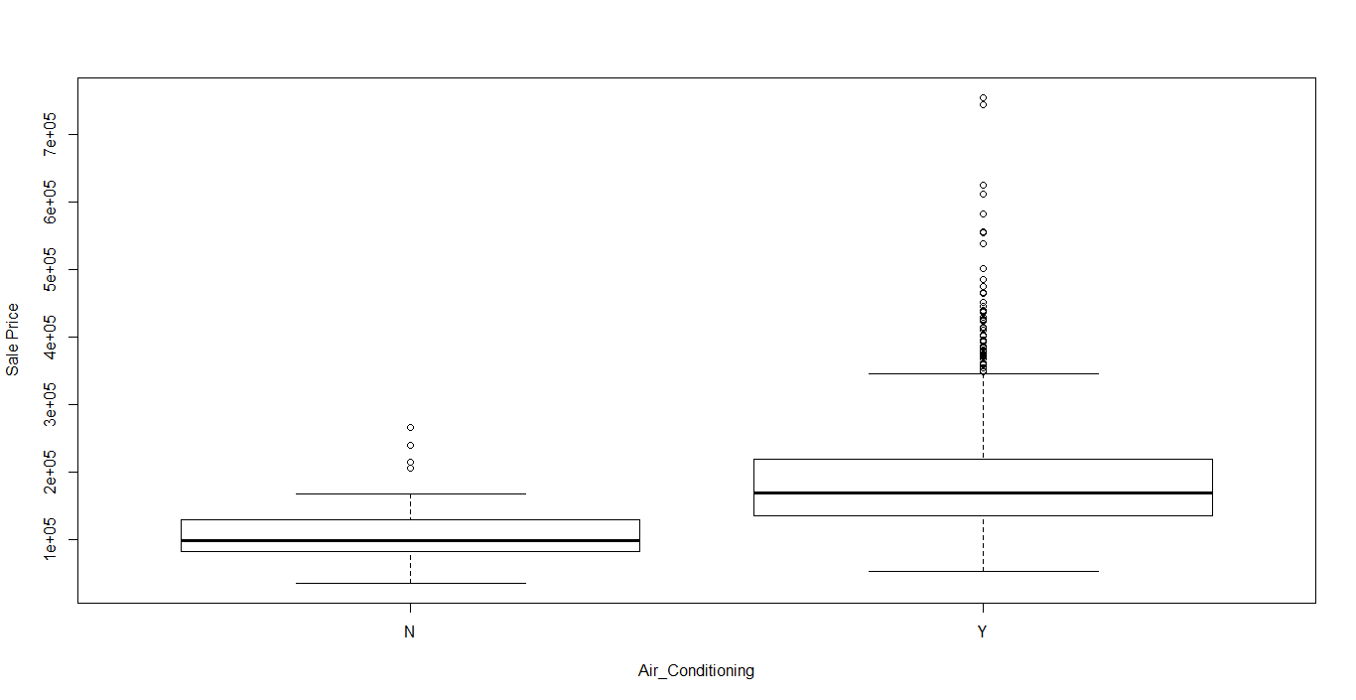
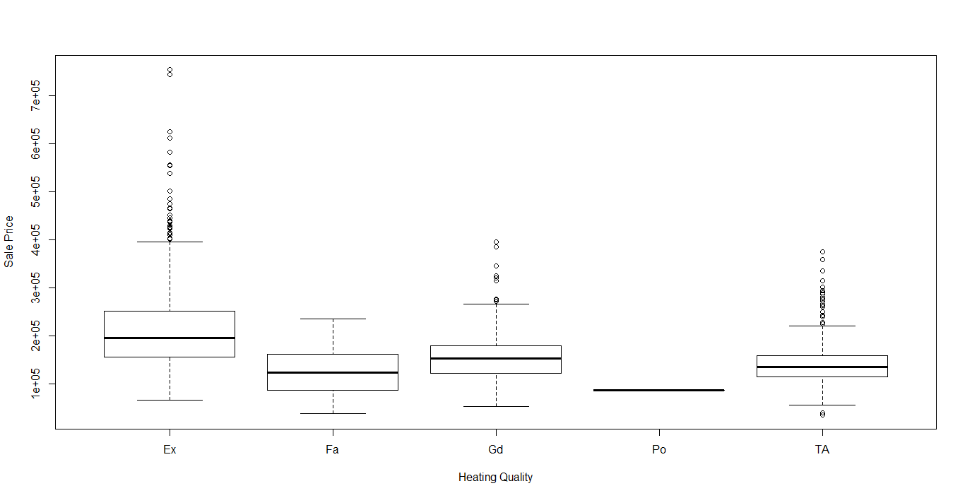
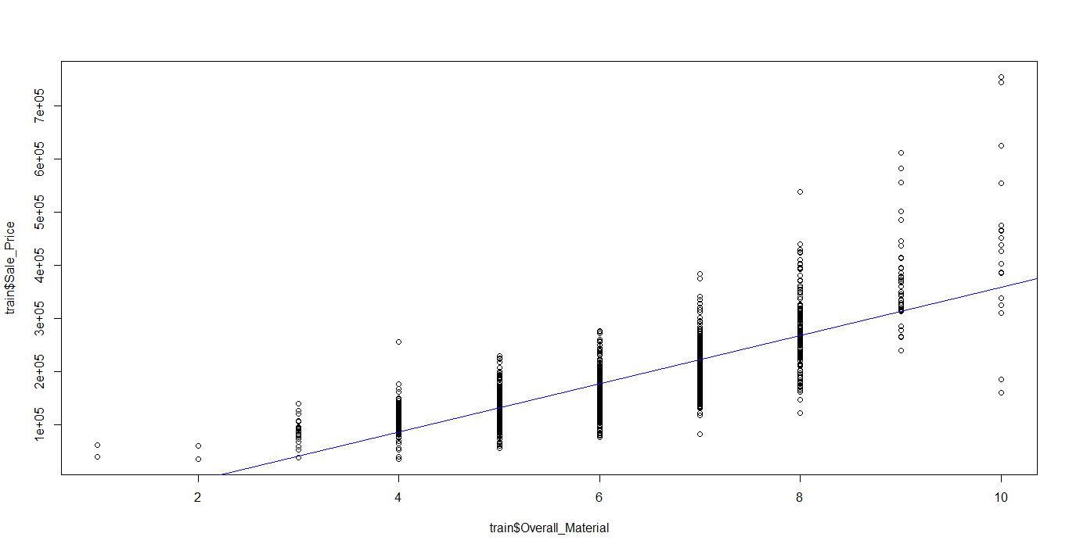
RELATIONSHIP WITH TARGET VARIABLE

Slide 5
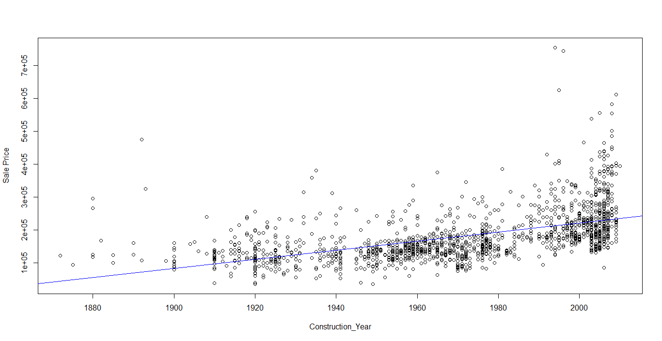
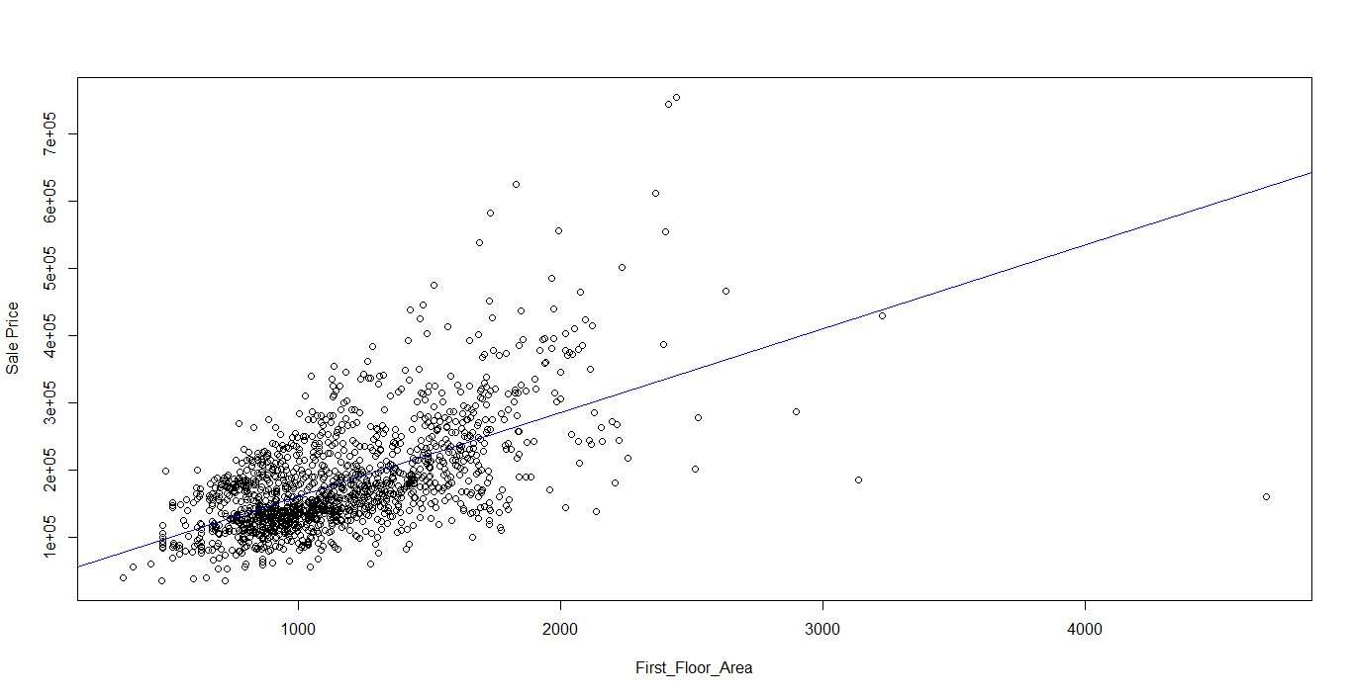
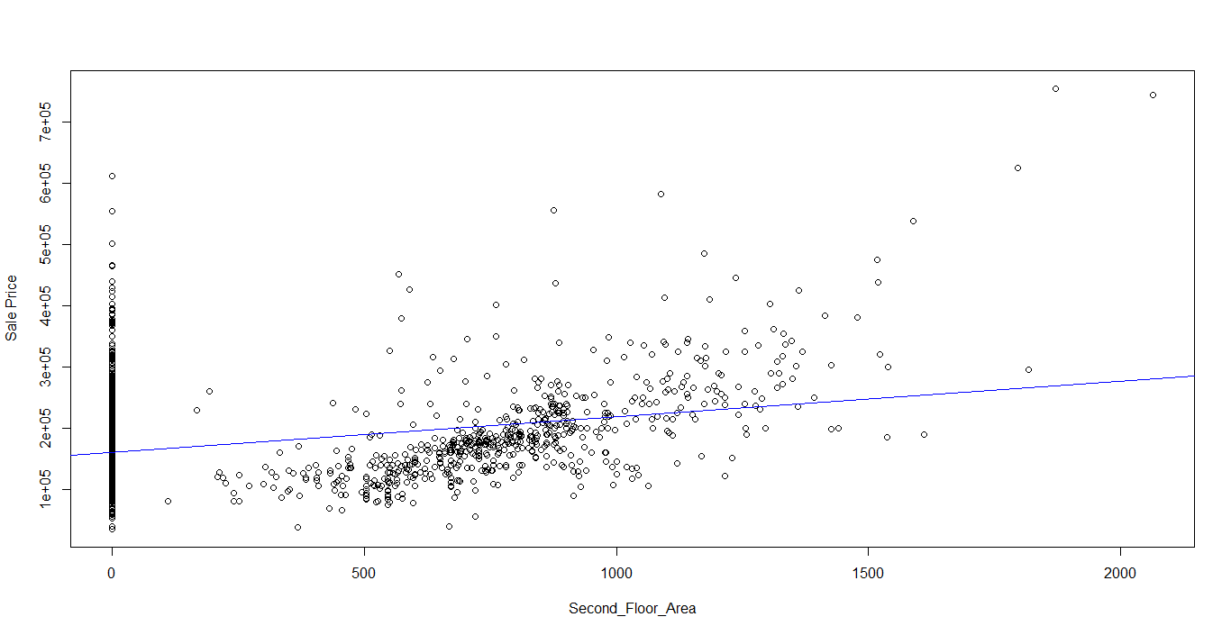
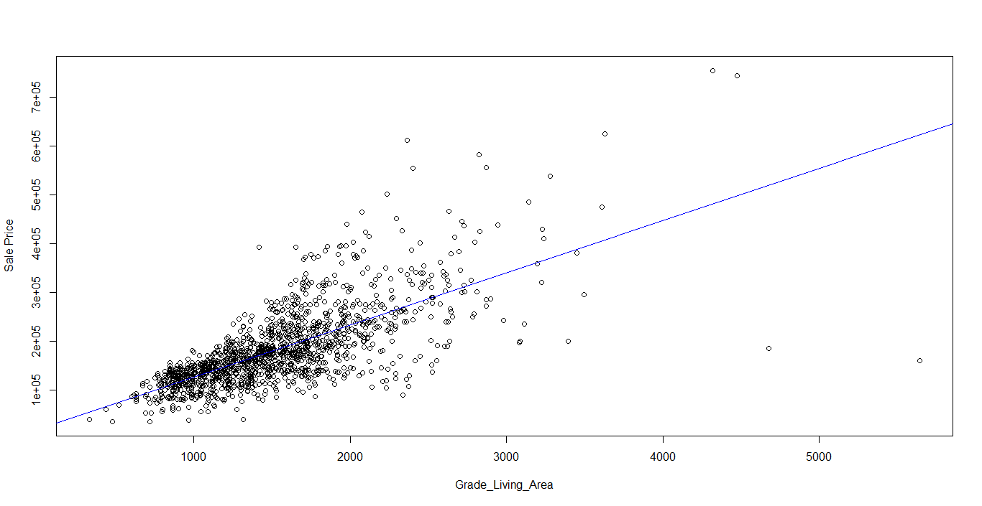
RELATIONSHIP WITH TARGET VARIABLE

Slide 6
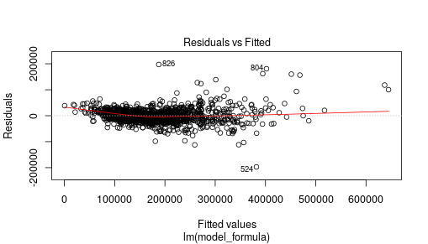
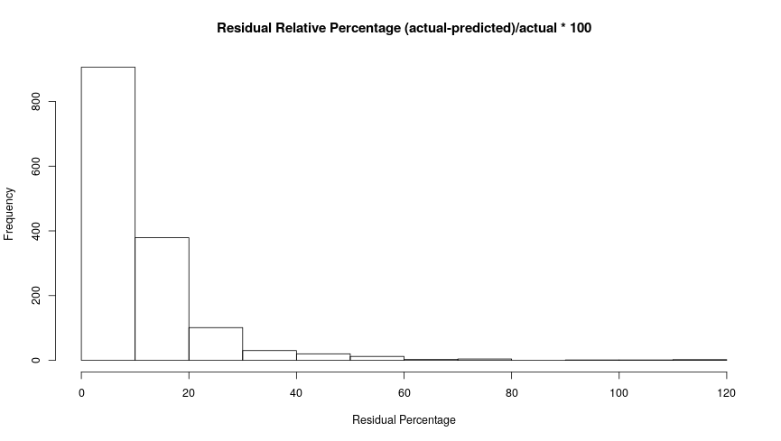
Model 1
Adjusted R-squared | 0.8888
RSME | 26113
Number of Variables | 30 | 41
F-statistic | 285.3 on 41 and 1417 DF

Slide 7
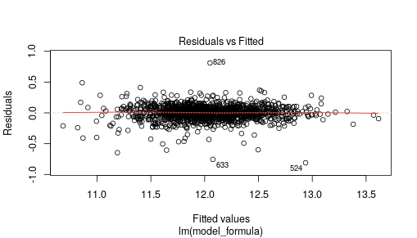
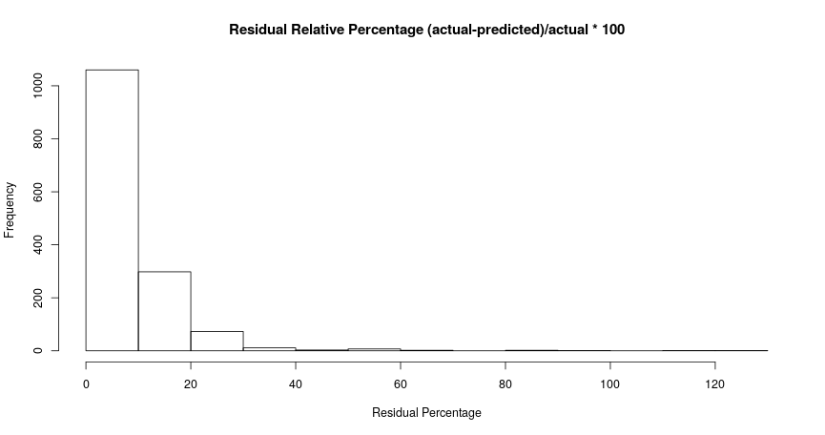
Model 1 (Normalised)
Adjusted R-squared | 0.9142
RSME | 22029
Number of Variables | 29 | 38
F-statistic | 409.7 on 38 and 1420 DF

Slide 8
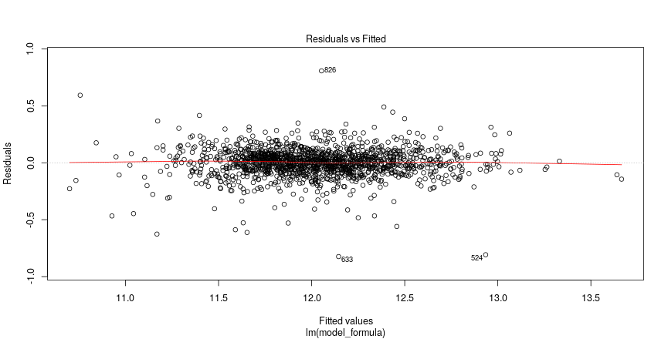
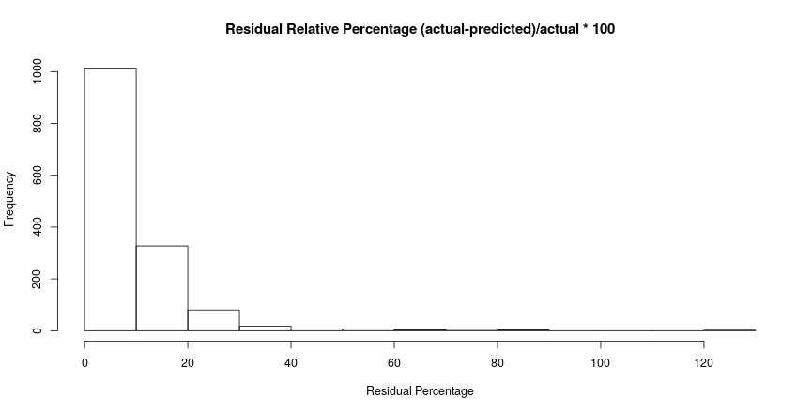
Model 2
Adjusted R-squared | 0.9025
RSME | 24031
Number of Variables | 19 | 19
F-statistic | 711 on 19 and 1439 DF

Slide 9
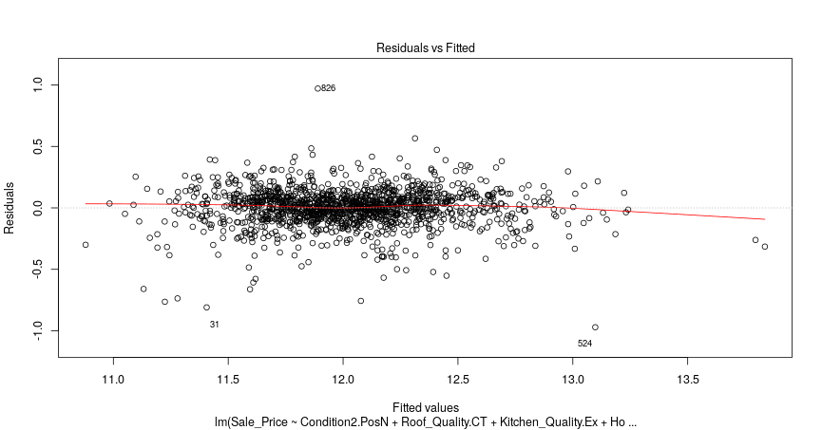
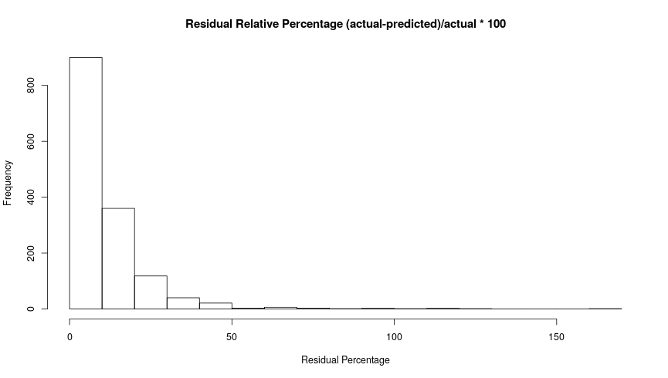
Model 3
Adjusted R-squared | 0.8534
RSME | 28038
Number of Variables | 11 | 11
F-statistic | 772.8 on 11 and 1447 DF

Slide 10
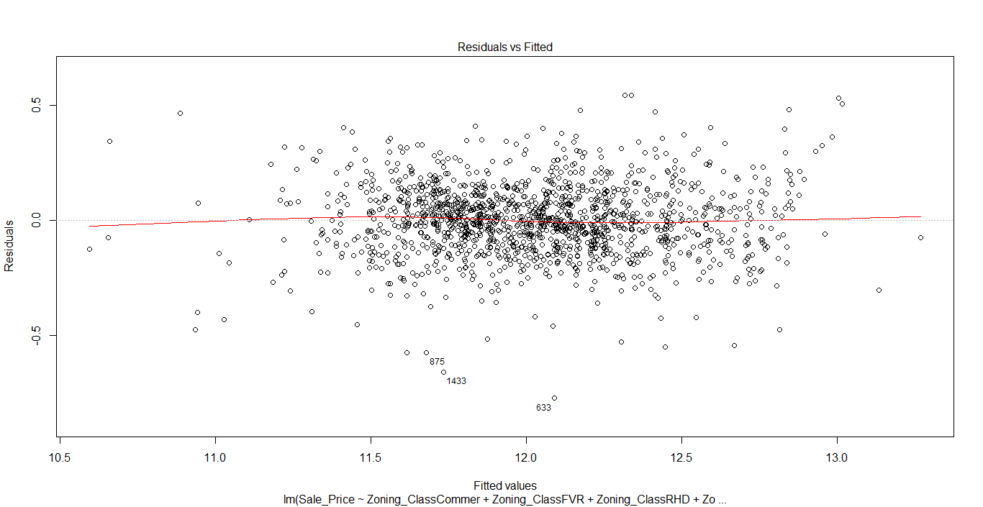
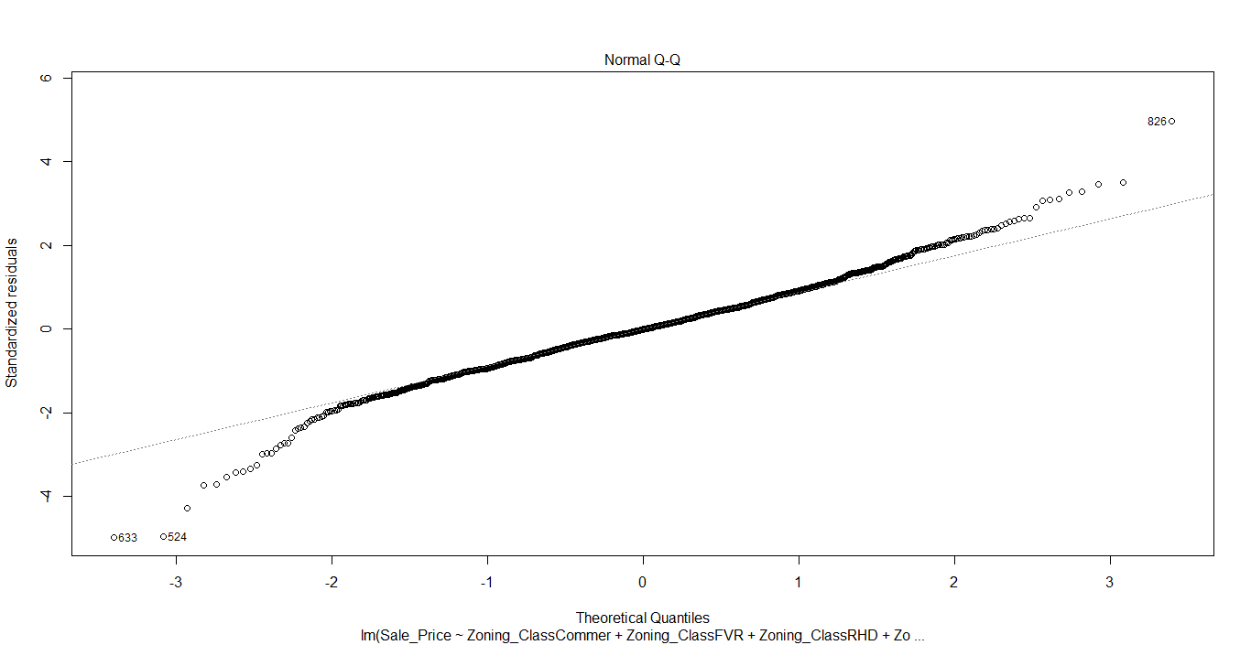
Model 4
Adjusted R-squared | 0.8526
RSME | 2334.796
Number of Variables | 35 | 35
F-statistic | 253.2 on 35 and 1423 DF

Slide 11
Common Features Identified (between models)
House_Condition
Construction_Year
BsmtFinSF1
BsmtFinSF2
BsmtUnfSF
First_Floor_Area
Second_Floor_Area
Garage_Size
Screen_Lobby_Area
Zoning_Class - Commer
Neighborhood - Edwards
Condition2 - PosN
Roof_Quality - CT
Heating_Quality - Ex
Air_Conditioning - N
Kitchen_Quality - Ex
Functional_Rate -MajD2
-Comparing the 4 different models , we are finalizing model 2 based on the Adjusted Rsquared and less number of predictors.

Slide 12
Thank you
Website:
https://yuvarajnachimuthu.wixsite.com/datarider
Github: https://github.com/srinathganesh1/Data-Riders/tree/master/LinearRegression

